Slide 1
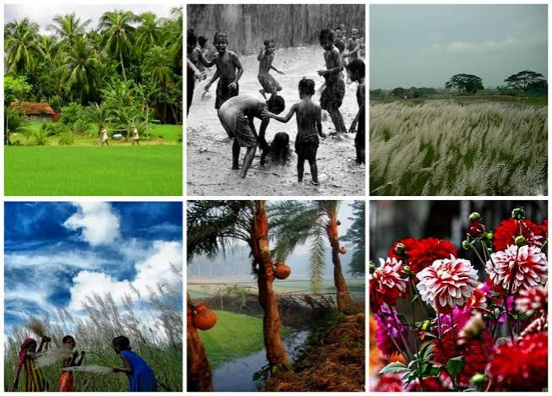

The Six Seasons of Bangladesh: A Journey Through Nature’s Rhythms
Exploring the Cultural and Environmental Significance of Bangladesh’s Unique Seasons

Slide 2

Introduction to Bangladesh’s Seasons
Introduce Bangladesh as a country with a tropical monsoon climate, giving it six distinct seasons instead of the four commonly experienced elsewhere.Explain how these seasons significantly impact the culture, lifestyle, and agriculture in Bangladesh.State the six seasons in order: Grismo (Summer), Barsha (Monsoon), Sharat (Early Autumn), Hemanta (Late Autumn), Sheet (Winter), and Boshonto (Spring).

Slide 3

Grismo (Summer): March to June
Overview: Grismo is the hottest season, with temperatures often exceeding 35°C (95°F).Climate Details: Characterized by intense heat, dry winds, and occasional thunderstorms.Impact on Daily Life: People adapt by wearing light clothing and seeking shade. Water sources are crucial to combat the heat.Agriculture and Nature: Mangoes, jackfruits, and lychees ripen during this season, and some farmers begin to prepare their fields for monsoon planting.

Slide 4

Barsha (Monsoon): June to August
Overview: Known as the season of rain, Barsha brings heavy monsoon rains essential for farming.Climate Details: High humidity, frequent thunderstorms, and heavy rainfall.Impact on Daily Life: Flooding is common, which impacts transportation but also revitalizes agriculture.Agriculture and Nature: Rice fields and rivers fill up, making this season vital for rice farming.

Slide 5

Sharat (Early Autumn): August to October
Overview: Sharat is marked by clearer skies, cooler temperatures, and gentle breezes.Climate Details: Mild and pleasant weather with lower humidity levels.Impact on Daily Life: People enjoy outdoor activities, and festivals like Durga Puja are celebrated during this season.Agriculture and Nature: Farmers prepare for the upcoming harvest, and water lilies bloom across the countryside.

Slide 6
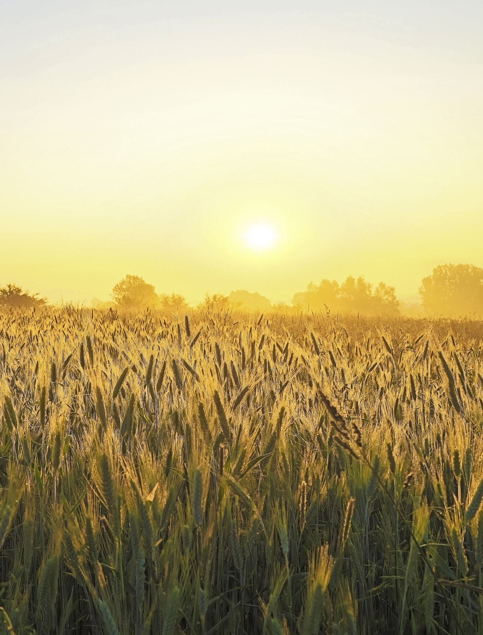
Hemanta (Late Autumn): October to November
Overview: Hemanta brings cooler weather and marks the transition into winter.Climate Details: Dry season with gradually dropping temperatures and misty mornings.Impact on Daily Life: People start wearing warmer clothes and celebrate the harvest.Agriculture and Nature: This is the primary harvest season for rice, and fields are filled with golden crops.

Slide 7

Sheet (Winter): November to January
Overview: Sheet is the coldest season, though temperatures remain mild compared to other countries.Climate Details: Clear skies, chilly mornings, and fog in some areas.Impact on Daily Life: People wear warmer clothes and enjoy seasonal foods like pithas (rice cakes).Agriculture and Nature: Vegetables like cauliflower and spinach grow well; mustard flowers bloom, adding vibrant yellow hues to the landscape.

Slide 8

Boshonto (Spring): January to March
Overview: Known as the season of flowers, Boshonto marks the transition from winter to summer.Climate Details: Pleasant temperatures, blooming flowers, and a fresh atmosphere.Impact on Daily Life: People celebrate the arrival of spring with Pohela Falgun (Bengali Spring Festival), wearing colorful clothes.Agriculture and Nature: Mango trees start to flower, and the countryside is alive with new growth.

Slide 9

Cultural Significance of Seasons
Discuss how each season shapes cultural traditions, festivals, and daily activities.Mention key festivals associated with different seasons, such as Durga Puja (Early Autumn), Nabanna (harvest celebration in Late Autumn), and Pohela Falgun (Spring).Describe how the changing seasons influence local cuisine, clothing, and family life.

Slide 10
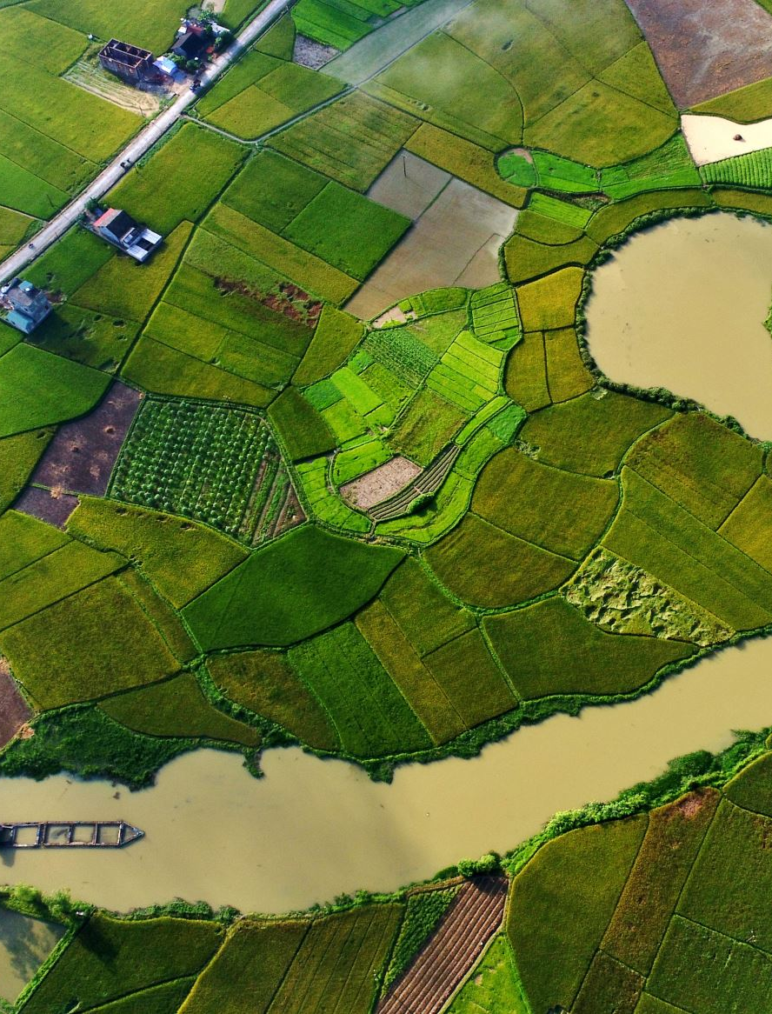
Conclusion
Recap: “In this journey through Bangladesh’s unique six-season cycle, we’ve explored how each season—Grismo (Summer), Barsha (Monsoon), Sharat (Early Autumn), Hemanta (Late Autumn), Sheet (Winter), and Boshonto (Spring)—brings its own climate, challenges, and celebrations.”Natural Harmony: “These natural rhythms not only shape the landscape but also cultivate a strong bond between the people and their environment. Each season affects daily life, from what people wear and eat to how they celebrate festivals, linking them deeply to nature’s cycles.”Cultural Impact: “The seasons have an immense impact on Bangladesh’s cultural heritage, festivals, and social traditions. This six-season structure is embedded in local literature, music, and art, highlighting a profound respect and reverence for nature.”Final Thought: “Bangladesh’s six seasons exemplify the beauty and diversity of life’s cycles. They remind us that with each new season comes change, growth, and renewal—values that resonate not only within nature but also in the hearts and lives of the people of Bangladesh.”

